Slide 2



Diving into Mastery Guidance for Educators
Each activity sheet is split into three sections, diving, deeper and deepest, which are represented by the following icons:
These carefully designed activities take your children through a learning journey, initially ensuring they are fluent with the key concept being taught; then applying this to a range of reasoning and problem-solving activities.
These sheets might not necessarily be used in a linear way. Some children might begin at the ‘Deeper’ section and in fact, others may ‘dive straight in’ to the ‘Deepest’ section if they have already mastered the skill and are applying this to show their depth of understanding.
Diving
Deeper
Deepest

Slide 3
National Curriculum Aim
Read, write, order and compare numbers to at least 1 000 000 and determine the value of each digit

Slide 4

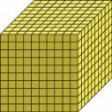

Numbers to 10 000
Diving
What numbers are being represented?
1403
1000
1000
1000
1000
100
100
100
100
100
100
100
1
1
1
1
1
1
1200
203
5300
4706
1403
8970
1000
1000
1000
1000
1000
1000
1000
10
10
10
1
1
1
1
1
5300
3670
5024
7035
8970

Slide 5
Numbers to 10 000
Diving
Complete this table.
 | + 10 | − 100 | + 100 | − 1000
7028 | 7038 | 6928 | 7128 | 6028
3950 | 3960 | 3850 | 4050 | 2950
6901 | 6911 | 6801 | 7001 | 5901
 |  | 1904
 | + 10 | − 100 | + 100 | − 1000
7028 | 7038 | 6928 | 7128 | 6028
3950 | 3960 | 3850 | 4050 | 2950
 |  |  | 7001
 |  | 1904
 | + 10 | − 100 | + 100 | − 1000
7028 | 7038 | 6928 | 7128 | 6028
3950
 |  |  | 7001
 |  | 1904
 | + 10 | − 100 | + 100 | − 1000
7028
3950
 |  |  | 7001
 |  | 1904
 | + 10 | − 100 | + 100 | − 1000
7028 | 7038 | 6928 | 7128 | 6028
3950 | 3960 | 3850 | 4050 | 2950
6901 | 6911 | 6801 | 7001 | 5901
2004 | 2014 | 1904 | 2104 | 1004
What happens to the digits in the number 3950 at each step?
When you add 10, the digit changes.
When you subtract 100, the digit changes.
When you add 100, the and digits change, as it crosses the
boundary.
When you subtract 1000, the digit changes.
. .
tens
. .
hundreds
. .
. .
hundreds
thousands
. .
thousands
. .
thousands

Slide 6

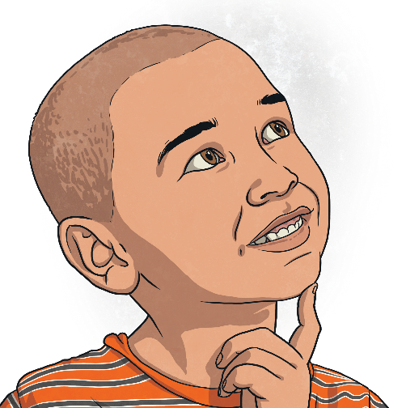
Numbers to 10 000
Deeper
Do you agree with Zeke? Explain your reasoning.
7904 + 100 = 8104
Zeke
Zeke is incorrect. The correct answer is 8004. He has added on 100 too many, which is a common error when counting across the thousands boundary.

Slide 7
Numbers to 10 000
Deeper
Amrit uses two examples to show that when you subtract 10 from any number, only the hundreds digit changes.
Is this always true? Prove it with an example.
2859 − 10 = 2849
5314 − 10 = 5304
Amrit
This is not always true. When you subtract 10 from a number with a 0 in the tens column already, one hundred will need to be exchanged into 10 tens to subtract 10, e.g. 9206 − 10 = 9196.

Slide 8

Numbers to 10 000
Deepest
Felix has counted up in steps of 10 from a given number.
He has reached 2037.
Felix
Write three positive numbers that he could have said.
There are various possible answers. For example: 87, 1587, 2007
The numbers must be positive, less than 2037 and have seven ones.
Write three numbers that he will say if he carries on.
There are various possible answers. For example: 5557, 7907, 8347
The numbers must be positive, more than 2037 and have seven ones.

Slide 9
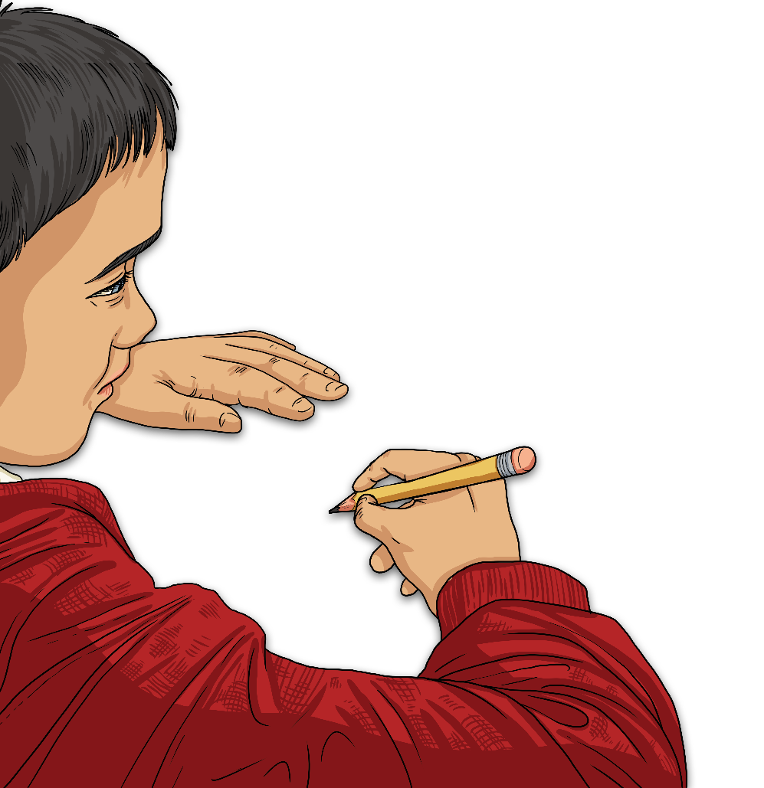
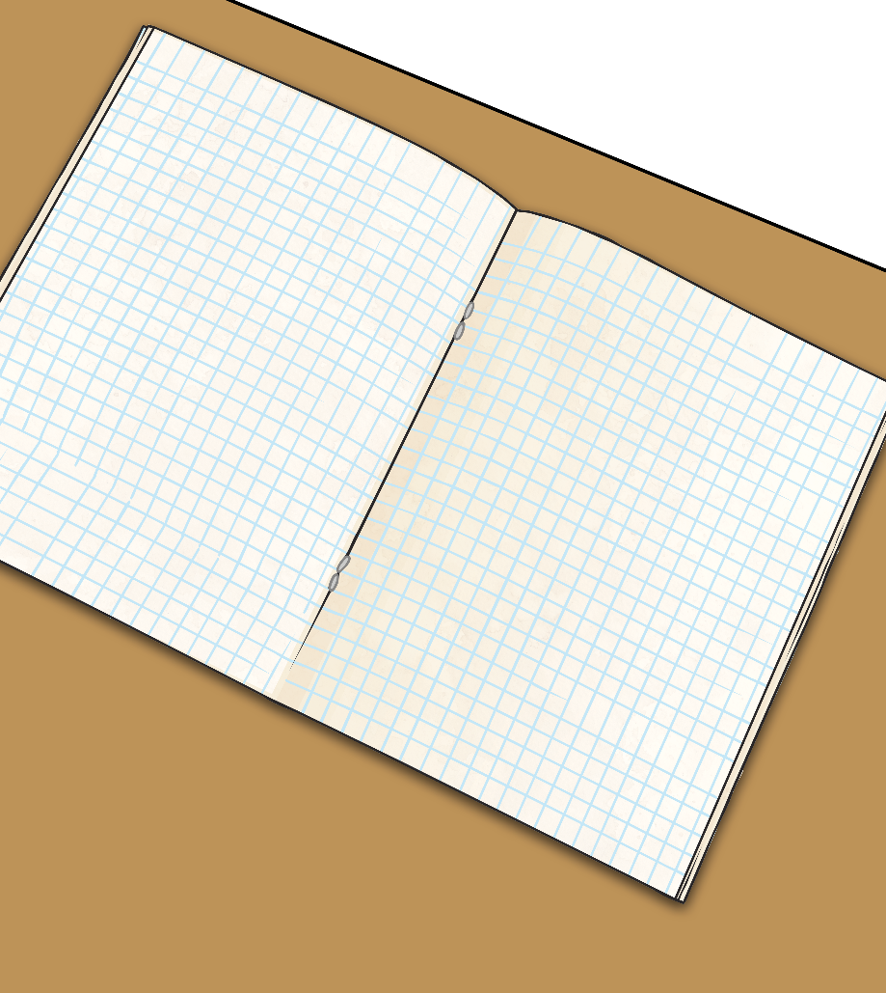
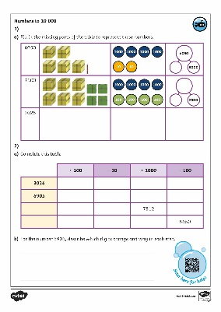
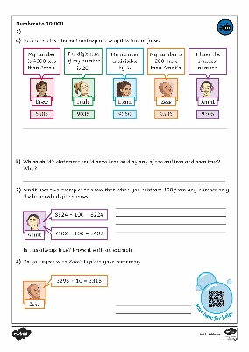
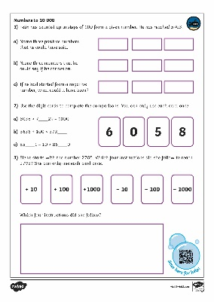
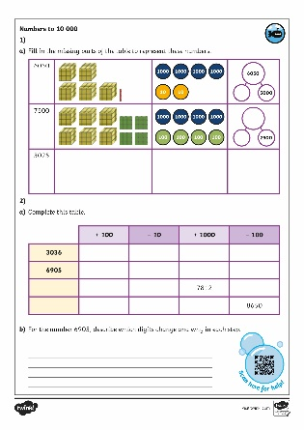
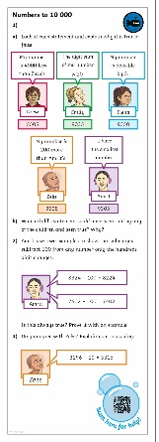
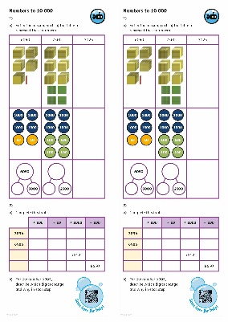
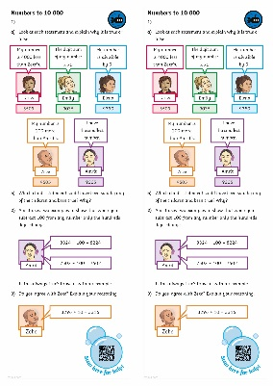
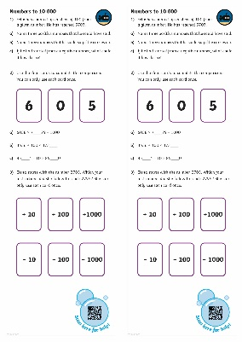
Numbers to 10 000
Dive in by completing your own activity!

Slide 10
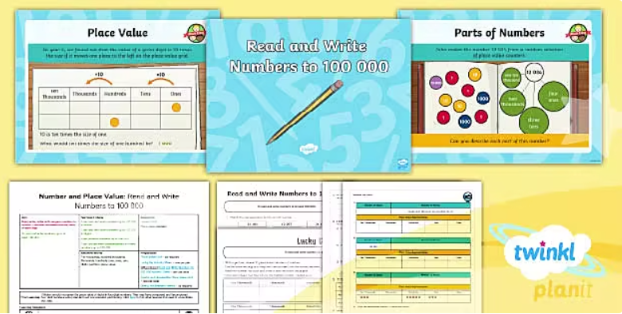
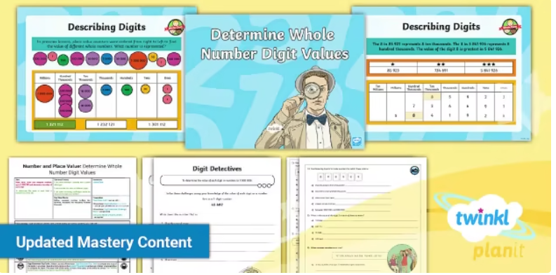

Need Planning to Complement this Resource?
National Curriculum Aim
Read and write numbers to at least 1 000 000 and determine the value of each digit
For more planning resources to support this aim, click here.
Twinkl PlanIt is our award-winning scheme of work
with over 4000 resources.

