Slide 1
Disclaimer/s
We hope you find the information on our website and resources useful.
Editable
This resource is editable and can be adapted to meet the needs of different children. Twinkl cannot be held responsible for any changes made once a resource has been downloaded. Please be aware that this content may have been edited and therefore may no longer reflect our values.
Animations
This resource has been designed with animations on each slide to make it as fun and engaging as possible. To view the content in the correct formatting, please view the slideshow in ‘presentation mode’. If you view the slides without selecting ‘presentation mode’, you may find that some of the text and images overlap each other or are difficult to read.
You may wish to delete this slide before beginning the presentation.

Slide 3



Diving into Mastery Guidance for Educators
Each activity sheet is split into three sections, diving, deeper and deepest, which are represented by the following icons:
These carefully designed activities take your children through a learning journey, initially ensuring they are fluent with the key concept being taught; then applying this to a range of reasoning and problem-solving activities.
These sheets might not necessarily be used in a linear way. Some children might begin at the ‘Deeper’ section and in fact, others may ‘dive straight in’ to the ‘Deepest’ section if they have already mastered the skill and are applying this to show their depth of understanding.
Diving
Deeper
Deepest

Slide 4
National Curriculum Aim
Identify multiples and factors, including finding all factor pairs of a number, and common factors of two numbers

Slide 5

Factors
Diving
Sort these numbers into the correct columns.
Remember that some may be factors of more than one number.
2, 4, 3, 7, 10, 6, 5
Factors of 15 | Factors of 20 | Factors of 24 | Factors of 35
3, 5
2, 4, 5, 10
2, 3, 4, 6
5, 7
1, 15
1, 20
1, 24, 12, 8
1, 35
Identify the missing factors for each number.

Slide 6
Factors
Diving
Complete these calculations.
3 × = 12
11 × 12 = 11 × 3 ×
× 8 = 16
10 × 16 = × 8 × 10
6 × = 54
6 × = 540
5400 = × 9
5400 = 90 ×
4
9
4
90
600
2
60
2

Slide 7


Factors
Deeper
Insert White Rose Aim Here
Bartek is identifying factors of 40.
25 and 15 are factors of 40.
Bartek
Explain the mistake he has made.
Factors are whole numbers that can be multiplied by another factor to make the given number or product.
(factor × factor = product)
Bartek is thinking of numbers that add together to make 40 rather than the factors of 40.

Slide 8
Factors
Deeper
Insert White Rose Aim Here
Is each statement true or false?
Explain your answers.
Odd numbers have fewer factors than even numbers.
This is false. Odd and even numbers can have the same number of factors. For example, 21 has 4 factors and so does 22.
12 is the only number less than 20 that has 6 factors.
This is false because 18 also has 6 factors which are 1, 18, 2, 9, 3 and 6.

Slide 9


Factors
Deepest
Solve this problem.
This year, my brother’s age is a factor of 24. Next year, his age will be a factor of 63.
Zeke
How old could Zeke’s brother be?
Find all possibilities.
Factors of 24: 1, 24, 2, 12, 3, 8, 4, 6
Factors of 63: 1, 63, 3, 21, 7, 9
Zeke’s brother could be 2, 6 or 8 years old.

Slide 10


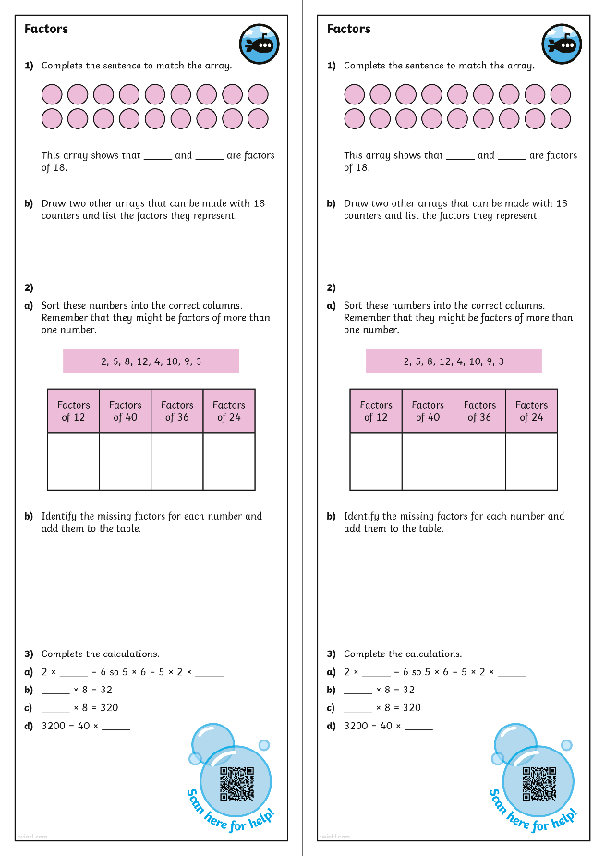
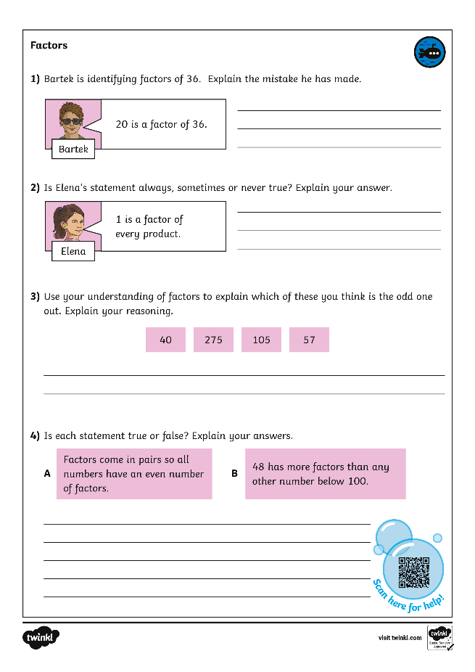
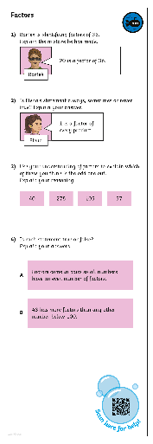
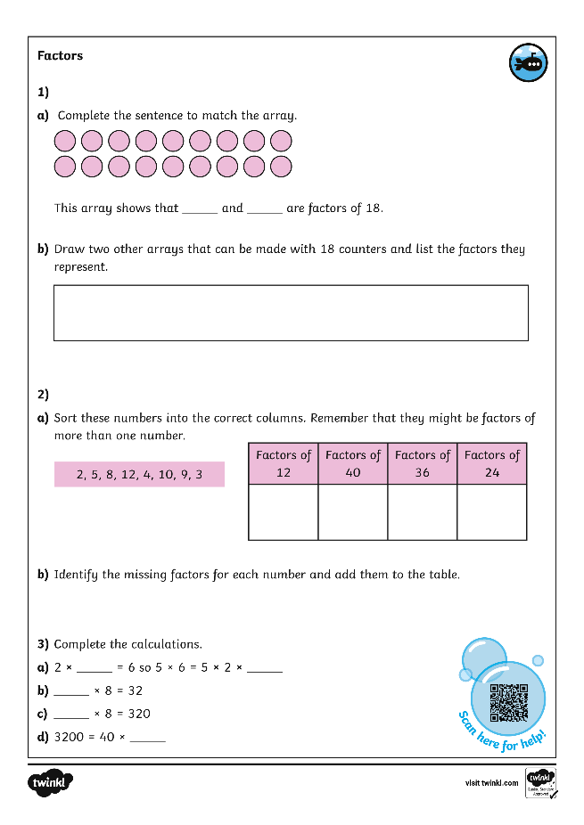
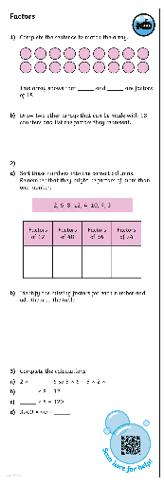
Factors
Dive in by completing your own activity!

Slide 11



Need Planning to Complement this Resource?
National Curriculum Aim
Identify multiples and factors, including finding all factor pairs of a number, and common factors of two numbers
For more planning resources to support this aim, click here.
Twinkl PlanIt is our award-winning scheme of work
with over 4000 resources.

